Slide 1
API’s Part 2
Class 14

Slide 2
Agenda
Homework 4
Useful SQL Functions
Debugging GET requests in Shiny
Project 2
Announcement

Slide 3
Homework 4

Slide 4
Homework 4
Mean | 93.9157895
Median | 97
StdDev | 6.3903802

Slide 5
Useful SQL Functions

Slide 6
DISTINCT
DISTINCT()
Every unique value of a column.
Placing TWO columns inside will return unique instances of both columns:
IE: DISTINCT(“REQUEST_TYPE”, “DEPARTMENT”)
Potholes, DPW Street Maintenance
Permits, Licenses & Inspections, Weeds/Debries …

Slide 7
IN statements
Useful for when you have an input that returns multiple
This works the same way %in% does in R
IE:
SELECT column_name(s) FROM table_name WHERE column_name IN (value1, value2, ...)
Checks to see if the value in the column matches any of the values in your list

Slide 8
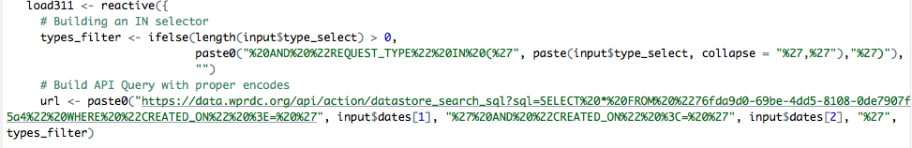
paste() Function with an IN statement
Collapse argument:
Places a separator if you have multiple arguments, works with columns & lists
Works similar to the sep argument

Slide 9
BETWEEN … AND
BETWEEN
Grab Values between two other values, like IN but for numeric values
Works like < and >
SELECT column_name(s) FROM table_name WHERE column_name BETWEEN value1 AND value2;

Slide 10
Min and Max
MIN()
Returns minimum value in a column(s)
MAX()
Return max value in a column(s)

Slide 11
Count, Average, Sum
COUNT() returns the number of rows that your query returns
SELECT COUNT(column_name) FROM table_name
AVG() returns the average value of a numeric column.
SELECT AVG(column_name) FROM table_name
SUM() function returns the total sum - numeric columns only
SELECT SUM(column_name) FROM table_name

Slide 12
Group by
This is helpful for when you are doing any of the summary functions mentioned in the previous slides. (COUNT, SUM, MAX etc)
Any column that isn’t handled with a function should be included in your GROUP BY
SELECT column_name(s), max(column_name) FROM table_name WHERE condition GROUP BY column_name(s)

Slide 13
Order By
Orders your returned tables by the column or columns in your ORDER BY statement
Often paired with either DESC or ASC after each column to indicate which way you would like the column ordered
DESC (high to low)
ASC – Default (low to high)
SELECT date_column, column_name(s) FROM table_name WHERE condition ORDER BY date_column DESC;

Slide 14
Debugging tips

Slide 15
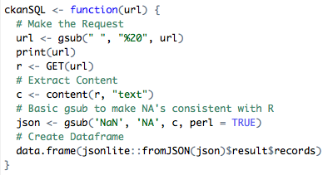
Print the URL in the middle of your reactive function

Slide 16

Create Dummy Filters
You don’t have to run the app every time, create the input list manually
Make sure to comment it out so it doesn’t run when you’re testing your app later.

Slide 17
Project 2: Due 10/19/18
To bring the entire course together students will create an interactive map that includes one (1) interactive map, one (1) datatable, and two (2) interactive charts or graphs. All data should be pulled from a web API’s. The app should have at least two different types of layers (points/markers, lines, heatmap or polygons) and at least four (4) input commands and the ability for the user to download the raw data they are viewing.
Applications should be deployed and working on shinyapps.io.

Slide 18

Want to work with R Shiny and the City of Pittsburgh?
Working on a description for next Spring semester
Work with Pubic Safety and I&P on migrating and redesigning the PBP Shiny App portfolio
I’ll be sending an email to the class once the announcement goes up

